Slide 1
Manage Development Lifecycles
what happens
between cradle and grave
Notes:
Will cover chapters 7, 8, 9, 20, 21, 36

Slide 2
Select Software Lifecycle
Given a project description, the learner will select the most suitable development lifecycle based on
  lifecycles described in text and notes
  criteria for lifecycle selection in text

Slide 3
Lifecycles
Development strategy that includes the process, methods and tools to organize generic phases
What should happen between project start and conclusion
Attempts to improve on “Chaos model”

Slide 4
Lifecycles Guide Us
Lifecycle models tell us
  what do we do next?
  when should we start doing it?
  When have we done enough to move on?
Lifecycles provide guidance on what can safely be postponed
Wrong model can cause slow work, repeated work, unnecessary work, and frustration
Notes:
Can anyone give an example of the last line?

Slide 5
Generic Phases
Definition phase
  what are we building
    concept definition, requirements
Development phase
  how are we building it
    design through commissioning
Maintenance phase
  correction, adaptation, enhancement
Notes:
Next several slides talk about the parts that a lifecycle is made of
These are basic to all projects, though details can vary a lot

Slide 6
Balancing Agility and Discipline
Current thoughts in lifecycles have diverged into competing philosophies
  plan-driven methods – high discipline
  agile methods – high flexibility
Neither is right or wrong
  proper choice depends on project characteristics and personnel characteristics
Real projects may choose a mixed model with best practices from each area

Slide 7
Common Lifecycles
Plan-Driven
  Pure/modified waterfall
  Staged delivery
  Personal/Team Software Process (PSP/TSP)
  Cleanroom
Agile
  Evolutionary prototyping
  Evolutionary delivery
  Scrum
  Unified Process
  Extreme Programming
Code-and-fix
Notes:
These are described in text,
will concentrate on evolutionary delivery, evolutionary prototyping and staged delivery
Comp 7081 sort of concentrated on waterfall
Design-to-tools, COTs - read in text.

Slide 8
Class Exercise 1
What lifecycle was used on your most recent project?
  did it answer the earlier questions?
What were the advantages?
What were the disadvantages?
Each group pick a project and report back
Notes:
EARLIER QUESTIONS:
what to do next
when should we do it
when are we done
Divide class into 4 groups to discuss and report out - 15-20 minutes

Slide 9
Classical Lifecycles
Waterfall model
Large development phases or big bang
Analysis and design finished before coding and test
Delivery date one or more years from start
Prototypes are 'throw away'
Notes:
6
Who thinks we need other than waterfall and why?
For that matter, does anyone still like the waterfall? It is useful on certain projects.

Slide 10
Waterfall Model
System
Engineering
Analysis
Is this model realistic?
Design
Implementation
Testing
Maintenance
Notes:
4
Problems with the Classic "Waterfall" Model
Real projects rarely follow strict sequential development.
It is very difficult to fully state all the requirements up front.
The customer does not often know exactly what his requirements are or does not provide all the necessary input to fully state the requirements.
This model demands patience from the customer. Working code is not available until very late into the project.
For rapid development, often has too much documentation

Slide 11
Staged Delivery
Statement of Work
Requirements
Analysis Phase
Software Requirements Specification
Preliminary
Design Phase
High Level Design Description
Build 1
DD
SDD
Build 2
CUT
CODE
Build 3
I&T
I&T
I&T
Tested System
Notes:
Here we deliver the builds (thus the name, staged delivery). If the builds are internal, and at the end there is a system test, then get waterfall with subprojects, p 145.
If you order the builds with highest priority first, get
design to schedule (stop when run out of schedule), see fig 7-10
What are advantages? - functionality in hands of customers earlier, may be able to deliver important parts first, if plan that way.
Disadvantages - requires careful planning at management and technical level to get meaningful stages, with the technical dependencies met.

Slide 12
Code-and-Fix
Seldom useful, but very common:
  Start with idea of what you want to build
  Informal design, code, debug and test
  Release when done
Low overhead, low training required
Hard to check progress, quality or risk
May be suitable for small proof-of concept programs

Slide 13
The Agile Manifesto – www.agilealliance.com
We are uncovering better ways of developing software by doing it and helping others do it.
Through this work we have come to value:
Individuals and interactions over processes and tools
Working software over comprehensive documentation
Customer collaboration over contract negotiation
Responding to change over following a plan
That is, while there is value in the items on the right, we value the items on the left more

Slide 14
Agile Lifecycles
Evolutionary prototyping
Evolutionary delivery
Scrum
Unified Process
Extreme Programming
Notes:
These are described in text,
will concentrate on evolutionary delivery, evolutionary prototyping and staged delivery
Comp 7081 sort of concentrated on waterfall
Design-to-tools, COTs - read in text.

Slide 15
Evolutionary Prototyping
Initial
concept
Design and
implement
initial
prototype
Refine prototype
until acceptable
Complete
and release
prototype
Notes:
7
Useful when requirements are changing rapidly, or when no one understands requirements
Also useful if architecture or algorithms are in doubt.
Disadvantage - impossible to know how long it will take to develop an acceptable product.
Can also be excuse to do code and fix development.

Slide 16
Scrum
Scrum is an agile methodology that has fixed iterations and usually low formality
Key practices:
  self-directed and self-organizing team
  no external addition of work to an iteration, once chosen
  daily stand-up meeting with special questions
  usually 30-calendar day iterations
  demo to external stakeholders at end of each iteration
  each iteration, client-driven adaptive planning

Slide 17
Extreme Programming (XP)
Most widely recognized agile method
Based on four values and twelve practices
Values:
  Communication
    force communications in a positive fashion
  Simplicity
    develop simplest product that meets customer's needs
  Feedback
    obtain and value feedback from the customer, the system, and each other
  Courage
    be prepared to make hard decisions that support the other principles and practices

Slide 18
XP Practices
Work performed by small teams with customer continuously present on-site
Begins with planning game with requirements captured as stories on index cards
System concept captured as metaphor for single vision of success
Fundamental short cycle time (iteration) no more than three weeks
Process assumes collective ownership so anyone can work on anything

Slide 19
XP Practices
Simple design
Pair programming
Emergent design through refactoring
Coding standards established by team
Quality assured through test-first approach
Continuous integration
Sustainable pace through emphasis on 40-hour work week

Slide 20
Evolutionary Delivery
Software
Concept
Includes overall plan
Prelim.
Req. Anal.
Design
Architecture
Deliver
System
Develop
Version
Incorporate
Feedback
Deliver
Version
Update plan
Customer
Feedback
Notes:
Note additional notes in addition to diag 7-11 in text. We will cover evolutionary delivery more like Gilb, the inventor of it. This will be more planned than the text seems to emphasize, perhaps leaning more towards staged delivery, but with smaller steps

Slide 21
Evolutionary Delivery:
Alternate View
Initial
Planning
Analyse
Requirements
Define
Next Step
Design
Step
Adjust
Plans
Implement
Step
Evaluate
Step
Notes:
Totally unspecified as to methodology could be either structured or OO
This is another look at the same thing, expanding the “develop a version” box a bit. same thing, different emphasis.
Is it confusing to have two versions?

Slide 22
Evolutionary Delivery Principle
Deliver something to a real end-user
Measure added value to the user
Adjust design and objectives based on results
Notes:
11
Try to break mindset which is from waterfall
Often start modifying existing system (traditional methodology deals poorly with this)
Easier to test concepts if can start with a superstructure - (architecture critical for software) otherwise lots of time taken up with large parts of system to get small improvements

Slide 23
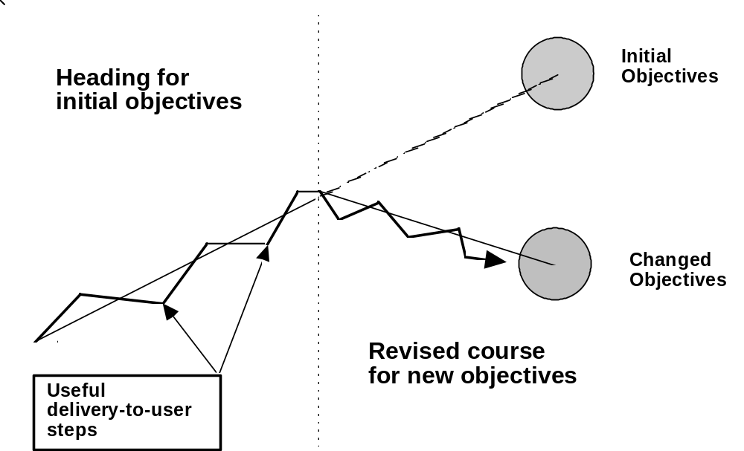
Evolutionary Cycle

Slide 24
Early, Frequent Iteration
Usually early delivery products are possible
  seldom considered
Evolutionary planning question:
  How little resources are required to accomplish something useful in the direction of objectives?
Select highest user-value per development cost for earliest step
Deliveries can be internal if customer does not want to be involved
Notes:
15
Although early delivery is possible, most people do not consider it. Lots of reasons: stability of requirements, design of whole system believed to create more stable software
Most projects could be subdivided 10-100 times.
Internal delivery may address HW issues which prevent delivery

Slide 25
Criteria for Iteration Selection
Highest value first
User value subjective
  Financial
  Political
  Risk reduction
Strive for early, visible results
Notes:
16

Slide 26
Complete Analysis, Design, Build and Test at Each Step
One of the great time-wasters in software projects:
  Detailed requirements analysis, followed detailed design, coding and test phases
Problem: can't adequately see far ahead enough to do it
Set measurable objectives for as far ahead as we can
Use open architecture, amenable to change
Set measurable goals for each step
  Use feedback to change as necessary
Notes:
This time waster is what we are almost required to do by older versions of MIL Spec
Objectives must be modified based on what we learn as we go along
See fig 7.5 on p 91 in Gilb (the evo cycle laid out) if steps not clear
May need to alter intermediate design, major architectural ideas, short-term/long-term objectives

Slide 27
Open-Ended Systems Architecture
Essential to help cope with change
Maintainability, portability, extensibility
Avoid trap of most current maintenance phases
Often a trade-off of short-term versus long-term
UNIX, X-windows, Free Software Foundation (FSF) examples
User Interface Management Systems (UIMS)
Open Systems Interconnect (OSI)
Common Object Request Broker Architecture (CORBA)
Notes:
Current maintenance phases often find excessive effort for modification due to documentation problems and architectural problems
GICS experience with DEC Pascal and FMS when wanting to port to UNIX
Manufacturers want to prevent open architectures if possible, e.g. Microsoft anti CORBA

Slide 28
Characteristics:
Evolutionary Steps
First feedback at end of first phase
Compare actual to planned:
  functionality, budget, quality factors
Each step should have fall-back position
Each step should provide useful results
Pick best features first
  if deliver juiciest bits first, you will be forgiven for not delivering their dreams
Notes:
23

Slide 29
Choosing Evolutionary Steps
What is best next step?
  Best value for effort
  Risk reduction
  May vary with reaction to earlier steps
  Can not always be preplanned
Avoid overplanning
Avoid underplanning
Notes:
24

Slide 30
Adjust Plans to Fit Reality
May need to adjust global estimates
May need to change architecture, hardware
May need to cancel project
Cheaper to redirect with evolutionary lifecycle
How-little principle
  ideal next evolutionary step: minimal cost, maximum user impact
Notes:
25

Slide 31
Benefits: Evolutionary Delivery
See reality at an early stage
  When can do something about it
Users feel involved and are more supportive
Project team has to cope with all aspects early
  Training, handbooks, HMI, error recovery, performance
Project team is calibrated quickly
Early experience with estimations
Team credibility for delivering early results
Budget cuts cannot result in total nondelivery
Notes:
36

Slide 32
Evolutionary Planning
Plans are not the same as reality
Plans are simplified models
Evolutionary planning closes gap to reality
  What we want
  How to get it
  What happens if...
Next slides cover how to do it

Slide 33
Technical Process
Identify and organize delivery steps
  Use lists of major functional requirements and development specifications
Top-down plan until smallest feasible steps identified
  Each step between 1% and 5% of project
Build solution on open-ended architecture
Notes:
Do value to cost ratio example in class

Slide 34
Value to Cost Ratio
Value
Cost
Step
Step sequence
Measure speed
Control Speed
Report speed
Calibrate measured mile
Suspend on breaks
Suspend on engine off
Test architecture

Slide 35
Cockburn's Levels of Method Understanding and Use
Level | Characteristics
3 | Able to revise a method (break its rules) to fit an unprecedented new situation.
2 | Able to tailor a method to fit a precedented new situation.
1A | With training, able to perform discretionary method steps (e.g. sizing stories to fit increments, composing patterns, compound refactoring, complex COTS integration). With experience, can become Level 2.
1B | With training, able to perform procedural method steps (e.g. coding a simple method, simple refactoring, following coding standards and CM procedures, running tests). With experience, can master some Level 1A skills.
-1 | May have technical skills, but unable or unwilling to collaborate or follow shared methods.

Slide 36
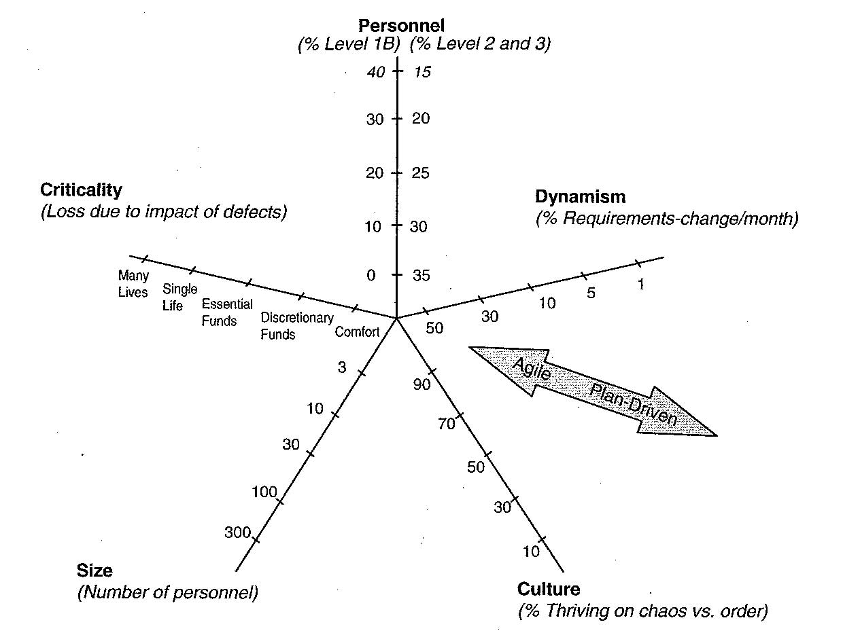
Dimensions Affecting Method Selection (Agile/Planned)
from Balancing Agility and Discipline by Grady Booch, et al.

Slide 37
Critical Factors in Choosing Agile/Plan-Driven 1/2
Factor | Agility Discriminators | Plan-Driven Discriminators
Size | Well-matched to small products and teams. Reliance on tacit knowledge limits scalability. | Methods evolved to handle large products and teams. Hard to tailor down to small projects.
Criticality | Untested on safety-critical products. Potential difficulties with simple design and lack of documentation. | Methods evolved to handle highly critical products. Hard to tailor down to low-criticality products.
Dynamism | Simple design and continuous refactoring excellent for highly dynamic environments, source of potentially expensive rework for highly stable environments. | Detailed plans and Big Design Up Front excellent for highly stable environment, but source of expensive rework for highly dynamic environments.

Slide 38
Critical Factors in Choosing Agile/Plan-Driven 2/2
Factor | Agility Discriminators | Plan-Driven Discriminators
Personnel | Requires continuous presence of a critical mass of scarce Cockburn Level 2 or 3 experts. Risky to use non-agile Level 1B people, | Needs a critical mass of scarce Cockburn Level 2 and 3 experts during project definition. Can work with fewer later in the project unless environment is highly dynamic. Can usually accommodate some level 1B people.
Culture | Thrives in a culture where people feel comfortable and empowered by having many degrees of freedom. (Thriving on chaos). | Thrives in a culture where people feel comfortable and empowered by having their roles defined by clear policies and procedures. (Thriving on order).

Slide 39
Class Exercise
When should you choose
  waterfall
  modified waterfall
  spiral
  prototyping
  iterative
How do you address company software “cultural” biases?
Notes:
Prepare table using next slide

Slide 40
Lifecycle Strengths/Weaknesses
See table 7-1 on page 156 in text

Slide 41
Lifecycle Strengths/Weaknesses
See Table 7-1 on page 157 in text

